Slide 1
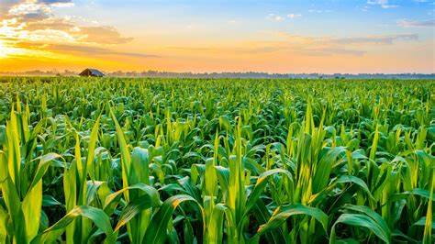
Crop Production Analysis In India
- By Dhanshri Manusmare

Slide 2
Project DETAILS
Project Title | Crop Production Analysis In India
Technologies | Business Intelligence
Domain | Agriculture
Project Difficulty Level | Advanced
Programming Language Used | Python
Tools Used | Jupyter Notebook, MS Office, MS PowerBI

Slide 3
oBJECTIVE
To get the insights of the crop production of various states and districts in the India. Insights include their production to area ratio , percentage area captured by each crop season and each crop category.
To get the insights about the top states according to crop season , top crops with higher average of area and production. These insights will help the stakeholders to decide which crop have more yield in which state or district and will help them to take decisions accordingly to get economical benefits.

Slide 4
PROBLEM STATEMENT
This dataset provides a huge amount of information on crop production in India ranging from several years. Based on the Information the ultimate goal would be to predict crop production and find important insights highlighting key indicators and metrics that influence the crop production.

Slide 5

ARCHITECTURE
Real World
Raw Data Collection
Load Dataset
Data Cleaning
Deployment
Modeling
EDA
Reporting
Low Level Design Document
High Level Design Document
Architecture Document
Wireframe Document
Detailed Project Report

Slide 6
Dataset Information
State_name = Name of States in India (categorical : 'Andaman and Nicobar Islands', 'Andhra Pradesh', 'Arunachal Pradesh', 'Assam', 'Bihar', 'Chandigarh', 'Chhattisgarh', 'Dadra and Nagar Haveli', 'Goa', 'Gujarat', 'Haryana', 'Himachal Pradesh', 'Jammu and Kashmir ', 'Jharkhand', 'Karnataka', 'Kerala', 'Madhya Pradesh', 'Maharashtra', 'Manipur' , 'Meghalaya', 'Mizoram', 'Nagaland', 'Odisha', 'Puducherry', 'Punjab', 'Rajasthan', 'Sikkim', 'Tamil Nadu', 'Telangana ', 'Tripura', 'Uttar Pradesh', 'Uttarakhand', 'West Bengal’)
District_Name – Name of Districts in India (categorical: 'NICOBARS', 'NORTH AND MIDDLE ANDAMAN', 'SOUTH ANDAMANS', 'ANANTAPUR', 'CHITTOOR', 'EAST GODAVARI', 'GUNTUR', 'KADAPA','KRISHNA', 'KURNOOL', 'PRAKASAM', 'SPSR NELLORE', 'SRIKAKULAM', 'VISAKHAPATANAM', 'VIZIANAGARAM', 'WEST GODAVARI', 'ANJAW', 'CHANGLANG', 'DIBANG VALLEY', 'EAST KAMENG', 'EAST SIANG', 'KURUCropNG KUMEY', 'LOHIT', 'LONGDING', 'LOWER DIBANG VALLEY’, Etc)
Crop_Year = Year of Crop Production (Numerical: 2000, 2001, 2002, 2003, 2004, 2005, 2006, 2010, 1997, 1998, 1999, 2007, 2008, 2009, 2011, 2012, 2013, 2014, 2015)
Season = Season of the Crops (Categorical: 'Kharif', 'Whole Year ', 'Autumn', 'Rabi', 'Summer', 'Winter’)
Crop = Name of the Crop Sown (Categorical: 'Arecanut', 'Other Kharif pulses', 'Rice', 'Banana', 'Cashew', 'Coconut ', 'Dry ginger', 'Sugarcane', 'Sweet potato', 'Tapioca', 'Black pepper', 'Dry chillies', 'other oilseeds' , Etc ) 6 | P a g e C r o p P r o d u c t i o n A n a l y s i s
Area – Area Under cultivation (Numerical)
Production – Production of the crops (Numerical)

Slide 7
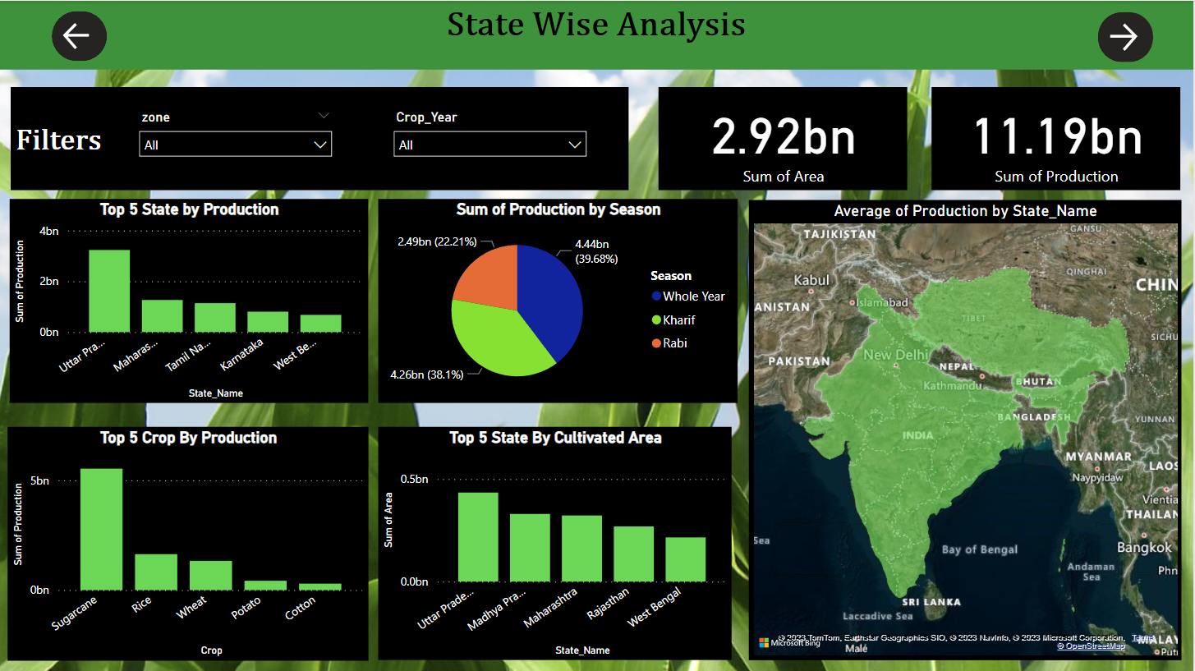
Visualizations/Dashboard

Slide 8
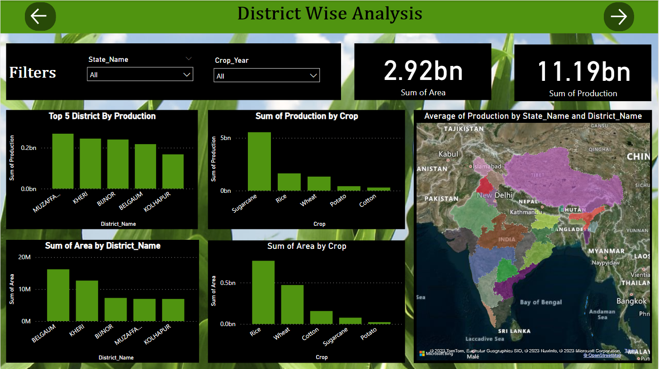

Slide 9
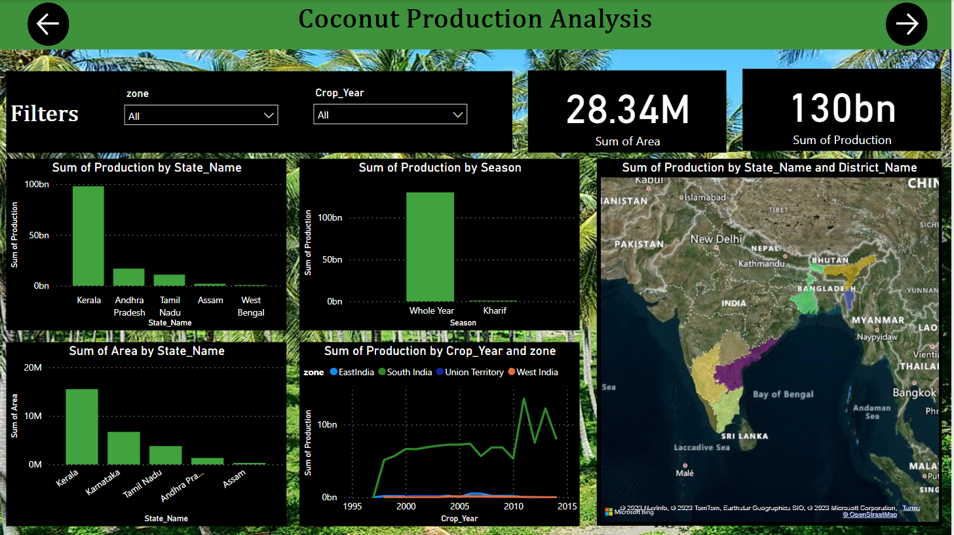

Slide 10
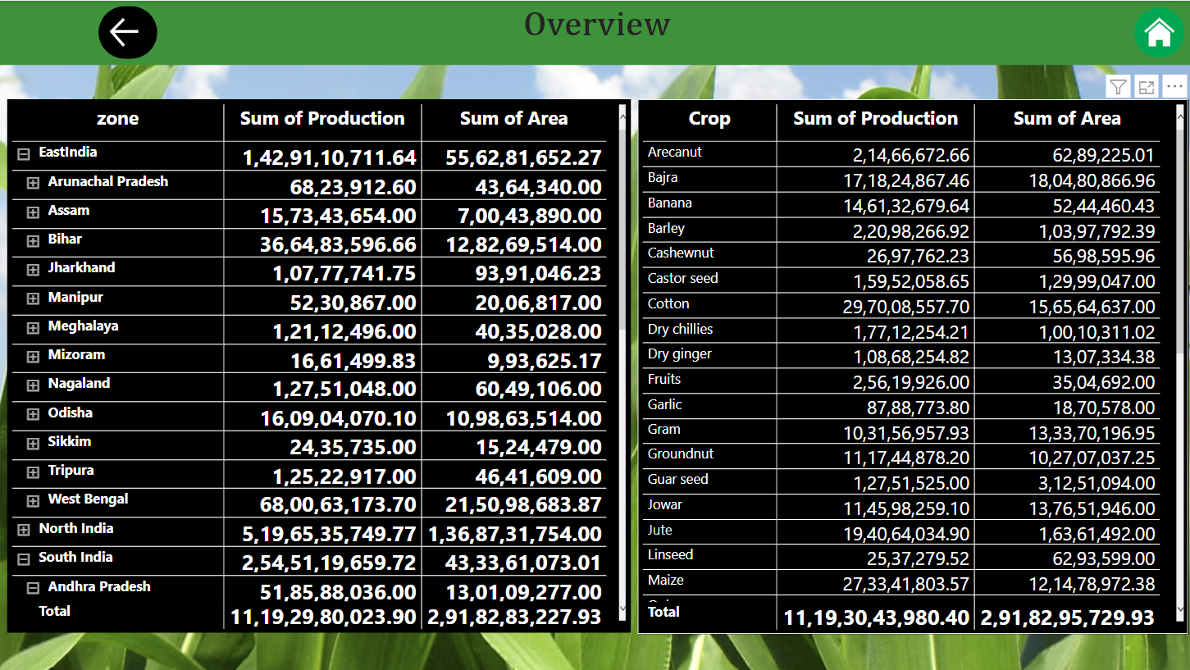

Slide 11
KPI
State Wise
Top 5 state by production
Top 5 crop by production
Sum of production by season
Top 5 state by cultivated area
District Wise
Top 5 state by production
Sum of production by crop
Sum of area by district
Sum of area by crop

Slide 12
Coconut Production Wise
Sum of production by state
Sum of production by season
Sum of production by area
Sum of production by crop year and zone

Slide 13
conclusions
State Wise
In India Top 5 State by Production are Uttar Pradesh, Maharashtra, Tamil Nadu, Karnataka, West Bengal respectively
Sugarcane, Rice, Wheat, Potato, Cotton are the Top 5 Crop as per Production respectively
Total production of Sugarcane is Highest Among All Crops
Maximum Production of Sugarcane Comes in Whole Year Season
Uttar Pradesh is having Highest Production and Cultivation area.
Total production of Rice is Second Highest Among All Crops
West Bengal is having Highest Production, but Cultivation area is highest in Uttar Pradesh
Maximum Production of Rice Comes Kharif Season
Total production of Wheat is Third Highest Among All Crops
Uttar Pradesh is having Highest Production and Cultivation area
Maximum Production of Wheat Comes in Rabi Season
North India Is Having Maximum Production Among All Zones
Maximum Production seen in 1997 and Minimum in 2015

Slide 14
District Wise
38 different types of crops are cultivating in 646 districts of India
Top 3 Districts in production and cultivation area belongs to Uttar Pradesh
In Every state some Districts are Dominating in Production and cultivation area like
In West Bengal - Murshidabad, Midnapur west, Bardhman Are Dominating
In Uttar Pradesh - Muzzfer Nagar, Kheri, Bijnor
If variety of crops are higher in state Dosent mean maximum production will come from same state
Coconut Production Wise
Coconut is having highest production of India
West Zone is having zero production of coconut
South zone is having highest coconut production
Kerla is having maximum production in South Zone which is approx 75% of total coconut production
Assam is having maximum production in East Zone • Goa is having maximum production in West Zone

Slide 15
Q & A
Q1) What’s the source of data?
Ans) The Dataset was taken from iNeuron’s Provided Project Description Document.
https://data.world/thatzprem/agriculture-india
Q2) What was the type of data?
Ans) The data was the combination of numerical and Categorical values.
Q 3) What’s the complete flow you followed in this Project?
Ans) Refer slide 5th for better Understanding
Q4) What techniques were you using for data?
Ans) -Removing unwanted attributes -Visualizing relation of independent variables with each other and output variables -Removing outliers -Cleaning data and imputing if null values are present. -Converting Numerical data into Categorical values.
Q 5) What were the libraries that you used in Python?
Ans) I used Pandas, NumPy and Matplotlib and Seaborn libraries in Pandas.

Slide 16
Thank you

